Slide 1
Comparison of Neighborhoods
Berlin – London – New York
Markus Gorges
November 12, 2020

Slide 2
Comparison of Neighborhoods
Problem
Comparison of neighborhoods of three different citys
Berlin
London
New York
Which city fits most the given interests?
Would would a ranking of neighborhoods look like?

Slide 3
Comparison of Neighborhoods
Data
Boroughs and neighborhoods from different web sources
Berlin: scrapping web page
London: import Excel-File
New York: import JSON
Combining with Data from Geolocator Nominatim
Latitude
Longitude
Combining with Venue Data from Foursquare
All venues in a given area
Comparison with interests

Slide 4
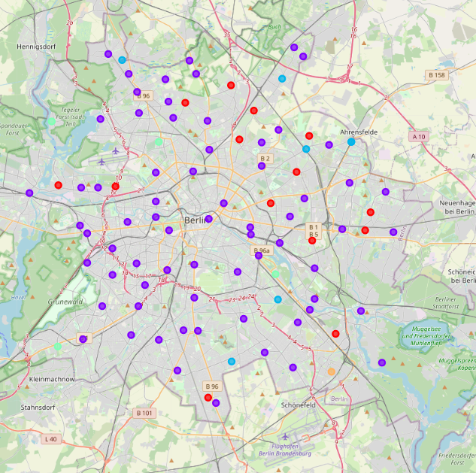
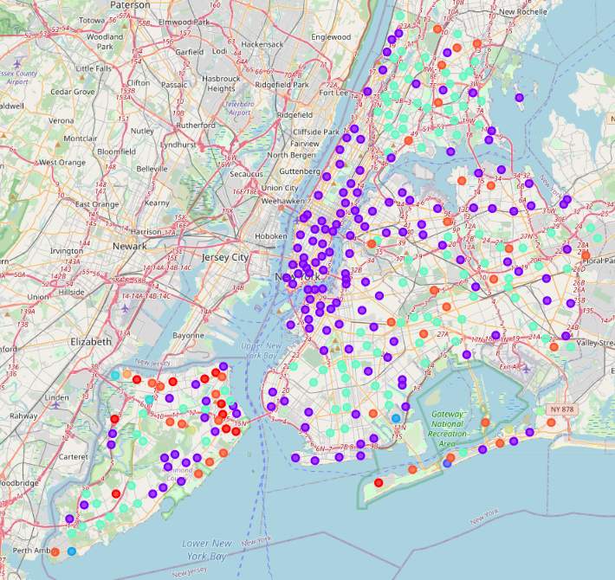
Comparison of Neighborhoods
Data analysis
Generating Clusters with Kmeans
Understanding which areas are the most likely to live
Understanding diversity of different citys

Slide 5
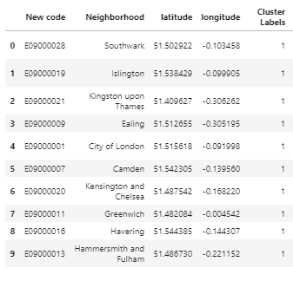
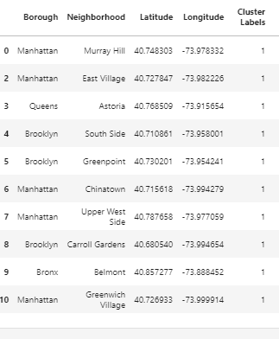
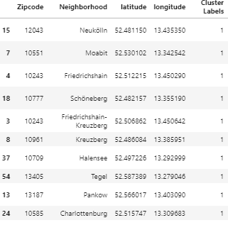
Comparison of Neighborhoods
Data analysis
Data analysis
Generating a ranking of each city
Regard of personel interests
Top 10 ranking

Slide 6
Comparison of Neighborhoods
Conclusion
With the given data and results I would recommend my friend to go to New York. And go for one of the top ten neighborhoods examined through the data analysis. Here he will find the biggest amount of diversity in his interests and has lots of venues to explore. As a second recommendation I would give him the advice to have a look at Berlin. Regarding the data it is more likely to live in Berlin than London.

